Slide 1

JAVA

Slide 2
What is Java?
It is a general purpose object oriented language which is designed for for easy development of web based applications.
It is known as WORA (Write Once Run Anywhere) - ie, after a program is written, we can run in any platform ex, linux or windos etc and so it is said to platform independent.
At first when a program is written, code will be with .java extension. After compliling(javac) it gets converted to .class file(java bytecode).
JVM (Java Virtual Machine) is a runtime environment that converts java byte code to machine code which is identified by the processor. Each computer has its own JVM.

Slide 3
Difference between JDK, JRE and JVM?
JDK (Java Development Kit): It is a software development kit that contains tools for developing, debugging etc. It contains tools required to write java programs. It includes a compiler, java application launcher, Appletviewer etc. Compiler converts .java files to .class files. Java applications launcher opens a JRE, loads the necessary classes and executes its main method. It is platform dependent. It always comes with an installer. It contains JVM.
JRE (Java Runtime Environment): It is a runtime environment that allows java programs to run. ie, provides an environment to execute the source code. JRE contains class libraries, JVM, Java plug-in and other supporting files and other integration libraries like JDBC, Remote Method Invocation, Java naming and Directory Interface(JNDI). It is platform dependent. JRE uses important package classes like math, util, lang, awt and runtime libraries. It contains JVM.
JVM (Java Virtual Machine): JVM (Java Virtual Machine) is a runtime environment that converts java byte code to machine code which is identified by the processor. Each computer has its own JVM. It is platform independent. It provides basic functions like memory management , garbage collection. It executes java program line by line and hence called as interpreter. It doesn't contain any tool.

Slide 4
OOPS Concept
Object-oriented programming has four basic concepts: encapsulation, abstraction, inheritance, and polymorphism. Even if these concepts seem incredibly complex, understanding the general framework of how they work will help you understand the basics of an OOP computer program. Below, we outline these four basic principles and what they entail:
Encapsulation
Abstraction
Inheritance
Polymorphism

Slide 5
Encapsulation And Abstraction
Encapsulation vs Data Abstraction
Encapsulation is data hiding(information hiding) while Abstraction is detailed hiding(implementation hiding).
While encapsulation groups together data and methods that act upon the data, data abstraction deal with exposing the interface to the user and hiding the details of implementation.
Advantages of Abstraction
It reduces the complexity of viewing the things.
Avoids code duplication and increases reusability.
Helps to increase the security of an application or program as only important details are provided to the user.

Slide 6
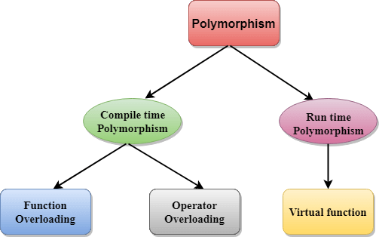
Polymorphism

Slide 7
INHERITANCE
Inheritance in Java is a mechanism in which one object acquires all the properties and behaviors of a parent object. It is an important part of OOPs (Object Oriented programming system).The idea behind inheritance in Java is that you can create new classes that are built upon existing classes. When you inherit from an existing class, you can reuse methods and fields of the parent class. Moreover, you can add new methods and fields in your current class also. Inheritance represents the IS-A relationship which is also known as a parent-child relationship. The extends keyword indicates that you are making a new class that derives from an existing class.
Why use inheritance in java
For Method Overriding (so runtime polymorphism can be achieved).
For Code Reusability.
Terms used in Inheritance
Class: A class is a group of objects which have common properties. It is a template or blueprint from which objects are created.
Sub Class/Child Class: Subclass is a class which inherits the other class. It is also called a derived class, extended class, or child class.
Super Class/Parent Class: Superclass is the class from where a subclass inherits the features. It is also called a base class or a parent class.
Reusability: As the name specifies, reusability is a mechanism which facilitates you to reuse the fields and methods of the existing class when you create a new class. You can use the same fields and methods already defined in the previous class.

Slide 8
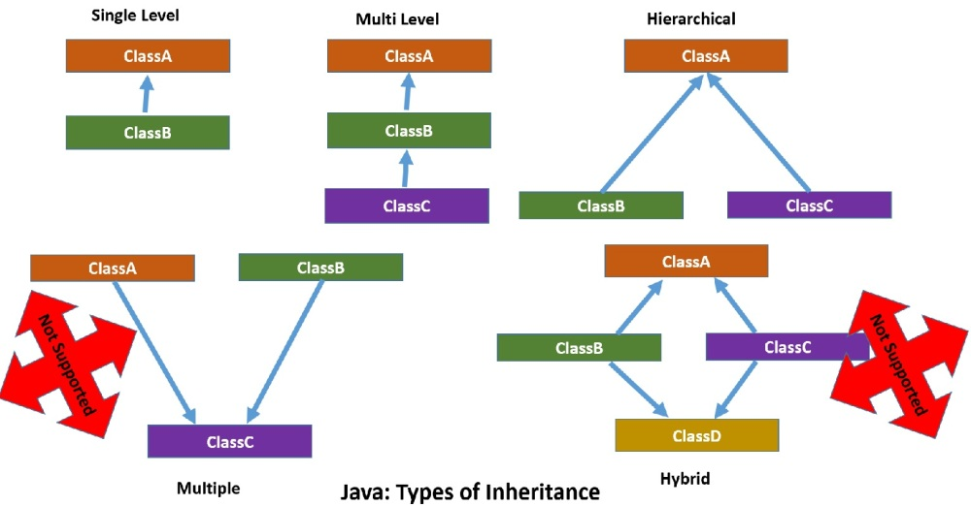

Slide 9
Diamond Problem in Java (Multiple Inheritance)
Java doesn''t support this type of inheritance, inorder to avoid a problem called "Diamond Problem".
This creates ambiguity problem ie., D is derived from B & C. Thus has 2 sum() functions that creates confusion on which sum function is to be called. So java doesn't
Support Multiple/Hybrid
Inheritance.
A
sum()
B
Sum()
C
Sum()
D
Sum() ?

Slide 10
Access Control Modifiers
Access Modifiers in Java helps to restrict the scope of a class, constructor, variable, method, or data member.
There are four types of Java access modifiers:
Private: The access level of a private modifier is only within the class. It cannot be accessed from outside the class.
Default: The access level of a default modifier is only within the package. It cannot be accessed from outside the package. If you do not specify any access level, it will be the default.
Protected: The access level of a protected modifier is within the package and outside the package through child class. If you do not make the child class, it cannot be accessed from outside the package.
Public: The access level of a public modifier is everywhere. It can be accessed from within the class, outside the class, within the package and outside the package.

Slide 11
Non –Access modifiers
Non-access modifiers are used in order to provide additional functionalities to a class, method, variable, or constructor. They are :
Static : when a variable is declared static, it is initialised only for one time. For example, When we call a function count() where I is initialised as 0 and is static, j declared as normal variable initialised as 0. So when we call count() twice where I and j is incremented by 1. For first execution ,new memory location is created for normal variable and static variable. Output : I=1,j=1; For second execution, new memory location is created for normal variable while same memory location is used by static variable. Changes are made to the value of the static variable. Output : I=2,j=1.
A static function cannot be called using object reference.
Class stu { static void count() { ----- } }
We cannot invoke like,
stu ob = new stu();
ob.count();
Instead, we can invoke like , stu.count();

Slide 12
Abstract : Used for creating abstract classes and methods. An abstract class should contain atleast an abstract function. An abstract function is the one which has no body definition.
Ex: abstract class abc { abstract void sum(); } // it has no body definition
An abstract class cannot be invoked with its object reference. abc ob = new abc() is wrong. It is possible to create object reference of type "abc" by creating a new class using "extend" keyword.
Class myclass extend abc
{
void sum() { }
}
Object can be now be created as abc ob = new myclass();
Final : When a variable is declared as final/constant, its value remains same till it has memory; Example : final int j=0 ; or final int k;
When a method is declared as final, it cannot be overridden.

Slide 13
Synchronised : The synchronized keyword used to indicate that a method can be accessed by only one thread at a time.
Volatile : The volatile modifier is used to let the JVM understand that a thread accessing the variable should always merge its own personal copy of the variable with the original in the memory. ... Volatile can only be applied to instance variables, which are of type object or private. A volatile object reference can be null.
PRIMITIVE DATA TYPES
The main difference between primitive and non-primitive data types are:
Primitive types are predefined (already defined) in Java.
Non-primitive types are created by the programmer and is not defined by Java (except for String ). ... A primitive type has always a value, while non-primitive types can be null .

Slide 14
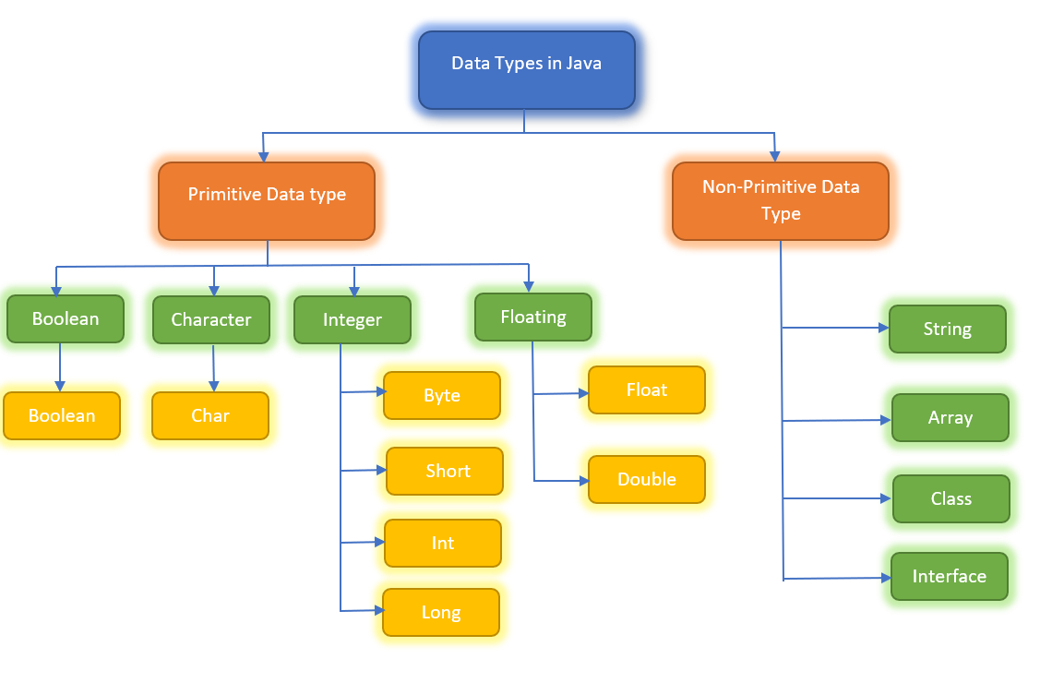
DATA TYPES IN JAVA

Slide 15
DATA TYPE CONVERSION
The process of converting one type of object and variable into another type is referred to as Typecasting.
When the conversion automatically performs by the compiler without the programmer's interference, it is called implicit type casting or widening casting. For example, a variable of type long (64-bit integer) can store any value that an int (32-bit integer) can store. In the following example, the compiler implicitly converts the value of num on the right to a type long before assigning it to bigNum.
Explicit type conversion is a type conversion which is explicitly defined within a program (instead of being done by a compiler for implicit type conversion). It is defined by the user in the program. Before the conversion is performed, a runtime check is done to see if the destination type can hold the source value.
The conversion is lossy because the variable int is larger in size than the data type byte. That is why the compiler thinks it’s not safe to convert the entire data type because it would lose data.

Slide 16
OPERATORS IN JAVA
Operators in Java are the special type of tokens in Java which when coupled with entities such as variables or constants or datatypes result in a specific operation such as addition, multiplication or even shifting of bits.
Java Operators are mainly of the following types:
Arithmetic Operators ( +,-,*,/,%) , Logical Operators( &&, ||)
Unary Operators ( post /pre --> Increment/decrement) [Ex: a++, ++a ]
Assignment Operators ( += , -= ,*= , /= , %=) [ Ex : a+=1; or a=a+1;]
Ternary Operators - (Condition)?(expression 1):(expression 2); [1>0? 1:0]
Relational Operators ( <, >, <=, >=, !=), Bitwise Operators (&,|,^,~), Shift Operators (<<,>>)
instanceOf operator: This is a type-check operator. It checks whether a particular object is the instance of a certain class or not. It returns true if the object is a member of the class and false if not.
public class InstanceOperator {
public static void main(String[] args) throws IOException {
InstanceOperator ob = new InstanceOperator();
System.out.println("Is ob an instance of InstanceOperator class? " + (ob instanceof InstanceOperator));
}
}

Slide 17
ITERATIVE STATEMENTS
In Java,loops that run for a predetermined number of times. The loop in Java follows a particular pattern. It contains the following parts: The initialization,The condition,The increment/decrement and The statements.
Types of loop
Int I;
1) for(i=0;i<5;i++) { loop body }
2) While(I>0){ I++;}
3) Do{ x=5; } while(I>0)
4) the syntax of Enhanced for loops is as follows.
for( T object : Collection)
{
//Code to be executed in the loop
}

Slide 18
DECISION MAKING STATEMENTS
Decision making in Java executes a particular segment of code based on the result of a boolean condition. It is important because conditions define the flow of programs and the output of a particular program.
The decision making principles in Java chiefly consist of if else statements, continue, break and switch statements. It decides the flow of the program control during the execution of the program.
There are the 6 ways of exercising decision making in Java: 1. if 2. if-else 3. nested-if 4. if-else-if 5. switch-case 6. jump-break, continue,
7. return
(This keyword, when executed by the compiler, returns the control back to the method it was called from. This is generally used in methods which are not of the void type and return some values

Slide 19
ARRAYS
Arrays are a collection of data items that have the same data type and referred to by a common name. Each array element is stored in such a way that each element can be calculated by applying a mathematical formula on its index. For example, an Integer array will have all integer elements and a String array will have Strings for each element of the array.
The superclass of arrays is an Object.The interfaces Cloneable and Serializable are implemented by arrays.
When the arrays contain primitive datatypes they are stored in memory locations which are contiguous. However when arrays of objects are created, they are stored in heap memory.
Arrays always have indexes. These indices typically denote the position of each element in the array. Since the elements are in the contiguous format, the indexing is done from 0(the first element) till n-1 where n is the length of the array. For example, an array of length 5 would have indices ranging from 0 to 4 (5-1).
Java ArraysIndexOutOfBoundsException
For example, if an array is of length 6 then the program can use any index of the array in between 0 and 5. But sometimes the program tries to access elements outside this range. That is when the compiler throws a ArraysIndexOutOfBoundsException error

Slide 20
Types of Arrays
Single Dimensional Array :
The syntax for using the array literal declaration is:
datatype <var_name>[] = new datatype {element1,element2,element3….element n};
Ex : int arr[] = new int[] {1,2,3,4,5}; //initializing an array
Multi-Dimensional Array - Syntax:
<datatype>[][]<var_name>= new <datatype>[size1][size2]; or <datatype><var_name>[][]= new <datatype>[size1][size2];

Slide 21
Strings and its methods
The strings in java are a collection of characters bound by double quotes(“”). They are immutable, i.e once they are declared, their values cannot be changed.String can also be listed as an array of characters starting at the index 0 and ending with a null character (\0). This means that the first letter of the string is at index 0 to the last character of the string which is indexed at (length of the string-1). This is an individual datatype in Java.
There are two ways of declaring strings in Java
1). By using the new keyword String course = new String(“Java”);
2). By using the String literal. String course=”java”;
STRING METHODS
1) length- This method is particularly useful for finding out the length of the string. It returns an integer which is the length of the string.
The basic syntax of this method is <string variable>.length();

Slide 22
String Methods (cont...)
2. charAt- This returns the character at the particular index passed as an argument to this method. The syntax is <string variable>.charAt(<index>);
3. substring(int i)- This method returns a string which is a substring of the original string starting at the index passed as the argument to the method. This has a simple syntax of <String variable>.substring(<index>);
4. substring(int i,int j)- This method returns the substring which starts at the index i, given as the first argument to the method and ends at j, given as the second argument in the method. It has a simple syntax of <String variable>.substring(<index1>,<index2>);
5. concat- As the name suggests, this method is useful for concatenating two strings. Concatenating means adding together two entities. It has the syntax of <String-variable1>.concat(<String_variable2>); In place of the variables you can also use string literals directly. You can also concat strings by simple add operator Example- “Hello”+” DataFlair”; yields Hello DataFlair.

Slide 23
String Methods (cont...)
6. indexOf- This method returns the index of the first occurence of the character passed as an argument in the string.The syntax of the method is <string_variable1>.indexOf(<String_variable2>);
7. equals- This method returns true if both the strings are equal and false if they are not equal. It has a syntax of <String_variable1>.equals(<String_variable2>);
8. compareTo- This method compares the two strings in a lexicographical order. If both of the strings are equal it returns zero.The result is positive if the first argument string is greater than the second string, lexicographically. If not, the result is negative. It has a syntax of <variable1>.compareTo(<variable2>);
9. toLowerCase- Converts the string to lowercase. It has a syntax of <variable>.toLowerCase();
10. toUpperCase- Converts the string to uppercase. It has a syntax of <variable>.toUpperCase();
11. trim- Trims the string, i.e, removes all unnecessary spaces before and after the string. Note that it does not remove the spaces inside the string. It has a syntax like <variable>.trim();
12. replace- Returns the string by replacing all occurrences of the first character with the second character. It has a syntax <String_variable>.replace(<character1>,<character2>);

Slide 24
CLASSES AND OBJECTS
A class is the blueprint of all the objects that are derived from it. It represents the set of methods and properties that are common to all the objects which are referenced from it. It has the methods, variables which are common to all the objects it projects onto.
A class declaration in Java has the following parts:
1. Modifier: This determines the accessibility of the class whether its public(accessible to all) or private(accessible to limited members of the program. )
2. Class name: This , as the name suggests, is the name of the class. It should not be any keyword. Convention suggests that all class names should begin with a capital letter.
3. Superclass(if any): Superclasses will be explained when we learn about inheritance in the later chapters. For now it is enough to know that superclasses are mentioned in the class declaration when it inherits data from a super class. The keyword used is “extends”.
4. Interface(if any): Interfaces are mentioned, separated by commas, individually after the class definition.

Slide 25
OBJECTS
The traditional definition of an object goes as follows: “The objects are real life entities which are derived from classes.They share the same variables and methods but different values of them .”
Java Objects consists of:
1. State: The properties of an object is its state. Its reflected by the attributed possessed by the object
2. Behaviour: It is determined by the methods of the object. For example an object having a function to print (“Hello”) will be the behaviour of that particular object.
3. Identity: The name you allot to the object is its identity. It allows objects to interact with one another. Object names must be unique. Example- an object named as “Adam” references the person class.
Declaring Objects in Java – Syntax
<type> <object-name>; // type of the object is the class name
The process of converting an object into a serial of bytes is called serialization.The reverse of this process is called deserialization.

Slide 26
INITIALIZATION OF JAVA OBJECT
Whenever an object is created, the class it references to is said to be instantiated. As soon as the object is initialized, all the instance variables are copied and reserved into memory for each individual object that is created.
Java also uses constructors which have the same name of the class for initializing or storing values of the instance variables. It depends on whether the constructor has parameters or not.
Whenever an object is declared using the ‘new’ keyword the constructor is called. Even if a constructor is not defined then a default constructor is called. For example,
class Person
{
String name;String sex;
Person(String name, String sex) { this.name = name; this.sex = sex; }
}
public static void main(String[] args) throws IOException
{ Person adam = new Person("Adam", "Male"); }

Slide 27
CONSTRUCTORS
Constructors are special functions which are used to initialize member variables of a class. A constructor always has the exact same name as that of a class. When you create a new object of a class, the compiler calls the constructor of the class.
Ex : class Abc
{
Abc(){ ------------- } //no parameters
Abc(int x,float y) { -------------} //parameterized constructors – uses int, float
Abc(int x, int y) {----------- } //parameterized constructors – uses 2 int values
}
There are certain rules that we should keep in mind when writing constructors.
The constructor should have the same name as that of the class.
A constructor can not be static, final or synchronized.
You can use access modifiers to limit access to the constructor.

Slide 28
Types of constructors
Default constructor : If not Java compiler provides a no-argument, default constructor on your behalf. ... This is a constructor initializes the variables of the class with their respective default values (i.e. null for objects, 0.0 for float and double, false for boolean, 0 for byte, short, int and, long).
Parameterized Constructor : The parameterized constructors are the constructors having a specific number of arguments to be passed. The purpose of a parameterized constructor is to assign user-wanted specific values to the instance variables of different objects. A parameterized constructor is written explicitly by a programmer.
Copy Constructor : A copy constructor is a member function that initializes an object using another object of the same class. A copy constructor has the following general function prototype:
ClassName (const ClassName &old_obj);
1. When an object of the class is returned by value. 2. When an object of the class is passed (to a function) by value as an argument. 3. When an object is constructed based on another object of the same class. 4. When the compiler generates a temporary object.

Slide 29
Super Keyword
The super keyword refers to superclass (parent) objects. It is used to call superclass methods, and to access the superclass constructor. The most common use of the super keyword is to eliminate the confusion between superclasses and subclasses that have methods with the same name.
class c1
{
C1();
Void sum() { ------}
}
Class c2 extends c1
{
c2() { super(); int I=0; }
}
We invoke object like, c2 ob = new c2(); // it call constructor c2 and super() calls c1(). We can also invoke functions/variables as super.sum();

Slide 30
What is method overloading and overriding in Java?
Overloading occurs when two or more methods in one class have the same method name but different parameters. Overriding occurs when two methods have the same method name and parameters. One of the methods is in the parent class, and the other is in the child class.
The purpose of Method Overriding is that if the derived class wants to give its own implementation it can give by overriding the method of the parent class. When we call this overridden method, it will execute the method of the child class, not the parent class.
The final way of preventing overriding is by using the final keyword in your method. The final keyword puts a stop to being an inheritance. Hence, if a method is made final it will be considered final implementation and no other class can override the behavior.

Slide 31
"this" Keyword
this keyword in Java is a reference variable that refers to the current object of a method or a constructor. The main purpose of using this keyword in Java is to remove the confusion between class attributes and parameters that have same names.
Following are various uses of ‘this’ keyword in Java:
It can be used to refer instance variable of current class
It can be used to invoke or initiate current class constructor
It can be passed as an argument in the method call
It can be passed as argument in the constructor call
It can be used to return the current class instance

Slide 32
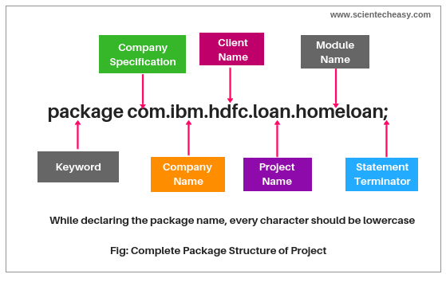
JAVA PACKAGES
A package is nothing but a physical folder structure (directories) that contains a group of related classes, interfaces, and sub-packages according to their functionality. It provides a convenient way to organize your work. The Java language has various in-built packages. For example, java.lang, java.util, java.io, and java.net. All these packages are defined as a very clear and systematic packaging mechanism for categorizing and managing. There are 2 types :
User-defined package : Java supports a keyword called “package” which is used to create user-defined packages in java programming. It has the following general form:
package packageName;

Slide 33
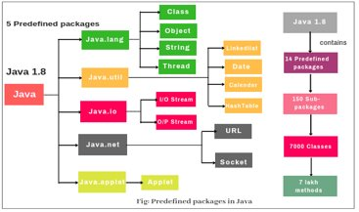
Pre-defined Package :

Slide 34
Regular Expression
Regular Expressions or Regex (in short) is an API for defining String patterns that can be used for searching, manipulating, and editing a string in Java. Email validation and passwords are a few areas of strings where Regex is widely used to define the constraints. Regular Expressions are provided under java.util.regex package.
. | Any character
\d | A digit: [0-9]
\D | A non-digit: [\^0-9]
\s | A whitespace character: [ \t\n\x0B\f\r]
\S | A non-whitespace character: [\^\s]
\w | A word character: [a-zA-Z_0-9]
\W | A non-word character: [\^\w]
Character Class | Description
[abc] | simple, matches a or b, or c
[\^abc] | negation, matches everything except a, b, or c
[a-c] | range, matches a or b, or c
^ | The beginning of a line
$ | The end of a line
\b | A word boundary
\B | A non-word boundary
\A | The beginning of the input
\G | The end of the previous match
\Z | The end of the input but for the final terminator, if any.
\z | The end of the input

Slide 35
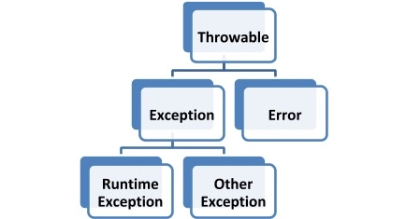
Exception Handling in Java
Exceptions are the unwanted errors or bugs or events that restrict the normal execution of a program. Each time an exception occurs, program execution gets disrupted. An error message is displayed on the screen. The parent class of all the exception classes is the java.lang.Exception class.
There are some important methods available in the Throwable class which are as follows:
public String getMessage() – Provides information about the exception that has occurred through a message, which is initialized in the Throwable constructor.
public Throwable getCause() – Provides root cause of the
exception as represented by a Throwable object.
public void printStackTrace() – Used to display the
output of toString() along with the stack trace
to System.err (error output stream).
public StackTraceElement [] getStackTrace() – Returns an array with
each element present on the stack trace. The index 0 element will symbolize the top
of the call stack, and the last element of array will identify the bottom of the call stack.

Slide 36
Exception Handling in Java (cont...)
There are mainly two types of exceptions in Java as follows:
Checked exception : Checked exceptions are also known as compile-time exceptions as these exceptions are checked by the compiler during the compilation process to confirm whether the exception is handled by the programmer or not. If not, then the system displays a compilation error. Ex: SQLException, IOException, InvocationTargetException, and ClassNotFoundException.
Unchecked exception : The unchecked exceptions are those exceptions that occur during the execution of the program. Hence they are also referred to as Runtime exceptions. These exceptions are generally ignored during the compilation process. They are not checked while compiling the program. For example, programming bugs like logical errors, and using incorrect APIs.
throw keyword : It is clearly displayed in the output that the program throws exceptions during the compilation process. There are two methods of resolving such issues. You can declare the exception with the help of the throw keyword.
Apart from the above-mentioned method, there is another way to resolve exceptions. You can manage them with the help of try-catch blocks.

Slide 37
Types Of Exceptions
SQLException : occurs while executing queries on a database related to the SQL syntax
IOException : This type of exception occurs while using file I/O stream operations.
ClassNotFoundException : due to a command-line error, a classpath issue, or a missing .class file.
InvocationTargetException : exception thrown by an invoked method or a constructor.
NullPointerException : exception occurs when you try to access an object with the help of a reference variable whose current value is null or empty.
ArrayIndexOutofBound : exception occurs when you try to access an array with an invalid index value. The value you are providing is either negative or beyond the length of the array.
IllegalArgumentException : exception occurs whenever an inappropriate or incorrect argument is passed to a method.
IllegalStateException : exception occurs when the state of the environment does not match the operation being executed.
NumberFormatException : exception occurs when you pass a string to a method that cannot be converted to a number.
ArithmeticException : exception occurs when you perform an incorrect arithmetic operation.

Slide 38
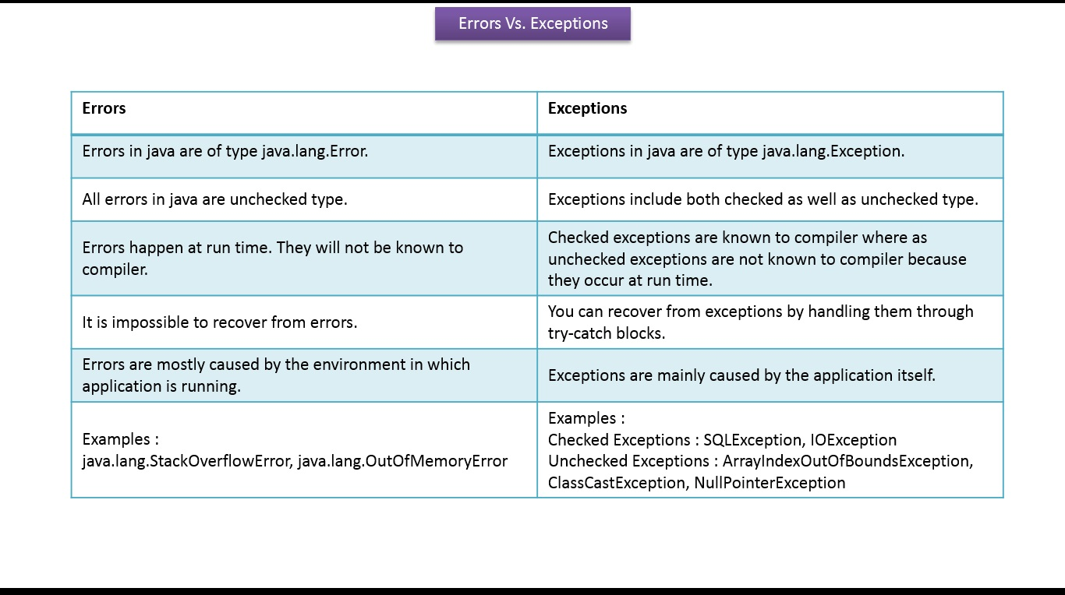
Exception Vs Error

Slide 39
Throw Vs Throws
throw | throws
throw keyword is used to throw an exception explicitly. | throws keyword is used to declare an exception possible during its execution.
throw keyword is followed by an instance of Throwable class or one of its sub-classes. | throws keyword is followed by one or more Exception class names separated by commas.
throw keyword is declared inside a method body. | throws keyword is used with method signature (method declaration).
We cannot throw multiple exceptions using throw keyword. | We can declare multiple exceptions (separated by commas) using throws keyword.
finally clause
A finally keyword is used to create a block of code that follows a try block. A finally block of code is always executed whether an exception has occurred or not. Using a finally block, it lets you run any cleanup type statements that you want to execute, no matter what happens in the protected code. A finally block appears at the end of catch block.

Slide 40
Garbage Collection
In java, garbage means unreferenced objects. Garbage Collection is process of reclaiming the runtime unused memory automatically. In other words, it is a way to destroy the unused objects. To do so, we were using free() function in C language and delete() in C++. But, in java it is performed automatically. So, java provides better memory management.
Advantage of Garbage Collection
It makes java memory efficient because garbage collector removes the unreferenced objects from heap memory.
It is automatically done by the garbage collector(a part of JVM) so we don't need to make extra efforts.
finalize() method
The finalize() method is invoked each time before the object is garbage collected. This method can be used to perform cleanup processing. This method is defined in Object class as:
protected void finalize(){}
Note: The Garbage collector of JVM collects only those objects that are created by new keyword. So if you have created any object without new, you can use finalize method to perform cleanup processing (destroying remaining objects).

Slide 41
Garbage Collection ( Cont...)
gc() method
The gc() method is used to invoke the garbage collector to perform cleanup processing. The gc() is found in System and Runtime classes.
public static void gc(){}
Note: Garbage collection is performed by a daemon thread called Garbage Collector(GC). This thread calls the finalize() method before object is garbage collected.
Example program :
public class TestGarbage1
{
public void finalize() { System.out.println("object is garbage collected"); }
public static void main(String args[])
{
TestGarbage1 s1=new TestGarbage1();
TestGarbage1 s2=new TestGarbage1();
s1=null; s2=null;
System.gc();
}
}

Slide 42
FILE CONCEPT IN JAVA
Java provides several API (also known as Java I/O) to read and write files. There are two types of Streams you can use to interact with files: Character Streams , and Byte Streams.
Character Streams
Character Streams are used to read or write the characters data type. All of these classes are defined under java.io package. Here are some classes you should know that can be used to read character data:
Reader: An abstract class to read a character stream.
InputStreamReader: Class used to read the byte stream and converts to character stream.
FileReader: A class to read the characters from a file.
BufferedReader: This is a wrapper over the Reader class that supports buffering capabilities. In many cases this is most preferable class to read data because more data can been read from the file in one read() call, reducing the number of actual I/O operations with file system.

Slide 43
And here are some classes you can use to write character data to a file:
Writer: This is an abstract class to write the character streams.
OutputStreamWriter: This class is used to write character streams and also convert them to byte streams.
FileWriter: A class to actually write characters to the file.
BufferedWriter: This is a wrapper over the Writer class, which also supports buffering capabilities. This is most preferable class to write data to a file since more data can be written to the file in one write() call. And like the BufferedReader, this reduces the number of total I/O operations with file system.
Byte Streams
Byte Streams are used to read or write byte data with files. This is different from before in the way they treat the data. Here you work with raw bytes, which could be characters, image data, unicode data (which takes 2 bytes to represent a character), etc.
Here are the classes used to read the byte data:
InputStream: An abstract class to read the byte streams.
FileInputStream: A class to simply read bytes from a file.
BufferedInputStream: This is a wrapper over InputStream that supports buffering capabilities. As we saw in the character streams, this is a more efficient method than FileInputStream.

Slide 44
And here are the classes used to write the byte data:
OutputStream: An abstract class to write byte streams.
FileOutputStream: A class to write raw bytes to the file.
ByteOutputStream: This class is a wrapper over OutputStream to support buffering capabilities. And again, as we saw in the character streams, this is a more efficient method than FileOutputStream thanks to the buffering.
Java NIO Streams
Java NIO is a non-blocking I/O API which was introduced back in Java 4 and can be found in the java.nio package. In terms of performance, this is a big improvement in the API for I/O operations.
Buffers, Selectors, and Channels are the three primary components of Java NIO, although in this article we'll focus strictly on using the NIO classes for interacting with files, and not necessarily the concepts behind the API.
As this tutorial is about reading and writing files, we will discuss only the related classes in this short section:
Path: This is a hierarchical structure of an actual file location and is typically used to locate the file you want to interact with.
Paths: This is a class that provides several utility methods to create a Path from a given string URI.
Files: This is another utility class which has several methods to read and write files without blocking the execution on threads.

Slide 45
WRAPPER CLASSES IN JAVA
The wrapper class in Java provides the mechanism to convert primitive into object and object into primitive.
Autoboxing and unboxing feature convert primitives into objects and objects into primitives automatically. The automatic conversion of primitive into an object is known as autoboxing and vice-versa unboxing.
Use of Wrapper classes in Java
To Change the value in Method.
To convert the objects into streams to perform the serialization.
Java synchronization works with objects in Multithreading.
java.util package provides the utility classes to deal with objects.
Java collection framework( ArrayList, LinkedList, Vector, HashSet,
LinkedHashSet, TreeSet, PriorityQueue, ArrayDeque, etc.) works
with objects only .
Primitive Type | Wrapper class
boolean | Boolean
char | Character
byte | Byte
short | Short
int | Integer
long | Long
float | Float
double | Double

Slide 46
Autoboxing And Unboxing ( Wrapper Classes – cont...)
The automatic conversion of primitive data type into its corresponding wrapper class is known as autoboxing, for example, byte to Byte, char to Character, int to Integer, long to Long, float to Float, boolean to Boolean, double to Double, and short to Short.
Ex : //Converting int into Integer
int a=20;
Integer i=Integer.valueOf(a);//converting int into Integer explicitly
Integer j=a;//autoboxing, now compiler will write Integer.valueOf(a) internally .
The automatic conversion of wrapper type into its corresponding primitive type is known as unboxing. It is the reverse process of autoboxing. Since Java 5, we do not need to use the intValue() method of wrapper classes to convert the wrapper type into primitives.
Ex : //Converting Integer to int
Integer a=new Integer(3);
int i=a.intValue();//converting Integer to int explicitly
int j=a;//unboxing, now compiler will write a.intValue() internally

Slide 47
INTERFACE
Another way to achieve abstraction in Java, is with interfaces. An interface is a completely "abstract class" that is used to group related methods with empty bodies. To access the interface methods, the interface must be "implemented" (kinda like inherited) by another class with the implements keyword (instead of extends). The body of the interface method is provided by the "implement" class.
Notes on Interfaces:
Like abstract classes, interfaces cannot be used to create objects (in the example above, it is not possible to create an "Animal" object in the MyMainClass), Interface methods do not have a body - the body is provided by the "implement" class, On implementation of an interface, you must override all of its methods, Interface methods are by default abstract and public, Interface attributes are by default public, static and final, An interface cannot contain a constructor (as it cannot be used to create objects)
Example for Interface ( in next page...)

Slide 48
interface Animal
{ public void animalSound(); // interface method (does not have a body) public void sleep(); // interface method (does not have a body) } class Pig implements Animal { public void animalSound() { // The body of animalSound() is provided here System.out.println("The pig says: wee wee"); } public void sleep() { // The body of sleep() is provided here System.out.println("Zzz"); } }

Slide 49
LAMDA EXPRESSIONS
Lambda expression is a new and important feature of Java which was included in Java SE 8. It provides a clear and concise way to represent one method interface using an expression. It is very useful in collection library. It helps to iterate, filter and extract data from collection. The Lambda expression is used to provide the implementation of an interface which has functional interface. It saves a lot of code. In case of lambda expression, we don't need to define the method again for providing the implementation. Here, we just write the implementation code.Java lambda expression is treated as a function, so compiler does not create .class file.
Functional Interface
Lambda expression provides implementation of functional interface. An interface which has only one abstract method is called functional interface. Java provides an anotation @FunctionalInterface, which is used to declare an interface as functional interface.
Why use Lambda Expression
To provide the implementation of Functional interface.
Less coding.

Slide 50
SYNTAX : (argument-list) -> {body}
Java lambda expression is consisted of three components : Argument-list: It can be empty or non-empty as well., Arrow-token: It is used to link arguments-list and body of expression., Body: It contains expressions and statements for lambda expression.
No Parameter Syntax
() -> {
//Body of no parameter lambda
}
One Parameter Syntax
(p1) -> {
//Body of single parameter lambda
}
Two Parameter Syntax
(p1,p2) -> {
//Body of multiple parameter lambda
}

Slide 51
Java In-Built Functional Interfaces
The java.util.function package defines several in-built functional interfaces that can be used when creating lambda expressions or method references.
1) Function Interface
The Function interface has only one single method apply(). It can accept an object of any data type and returns a result of any datatype.
2) Supplier Interface
A Supplier interface has only one single method called get(). It does not accept any arguments and returns an object of any data type.
3) Consumer Interface
The Consumer interface has only one single method called accept(). It accepts a single argument of any data type and does not return any result.
4) Predicate Interface
The Predicate interface has only one single method test(). It may be true or false depending on the values of its variables.

Slide 52
COLLECTIONS IN JAVA
The Collections in Java is a framework that provides an architecture to store and manipulate a group of objects. The Collection interface (java.util.Collection) and Map interface (java.util.Map) are the two main “root” interfaces of Java collection classes.
LIST​ | SET​ | QUEUE​ | MAP​
Array List​ | Hash Set​ | Deque ​ | Tree Map​
Linked List​ | Tree Set​ | Priority Queue​ | Hash Map​

Slide 53
ArrayList
ArrayList class internally uses a dynamic array for storing the elements. It inherits AbstractList class and implements ListInterface.
NOTES:
Can contain duplicate elements.
Maintains insertion order.
Is non-synchronised.
Allows random access because array works at the index basis.
Manipulation is slow because a lot of shifting needs to occur if any element is removed from the arraylist.
Syntax:
Let's see the old non-generic example of creating java collection.
ArrayList list=new ArrayList(); //creating old non-generic arraylist
Let's see the new generic example of creating java collection.
ArrayList<String> list=new ArrayList<String>(); //creating new generic arraylist

Slide 54
Example for ArrayList
import java.util.*;
public class ArrayListExample3{
public static void main(String args[]){
ArrayList<String> list=new ArrayList<String>();//Creating arraylist
list.add("Mango");//Adding object in arraylist
list.add("Apple"); list.add("Banana");
list.add("Grapes");
//Traversing list through for-each loop
for(String fruit:list)
System.out.println(fruit);
}
}

Slide 55
LinkedList
Java LinkedList class uses a doubly linked list to store the elements. It provides a linked-list data structure. It inherits the AbstractList class and implements List and Deque interfaces.
NOTES :
Java LinkedList class can contain duplicate elements.
Java LinkedList class maintains insertion order.
Java LinkedList class is non synchronized.
In Java LinkedList class, manipulation is fast because no shifting needs to occur.
Java LinkedList class can be used as a list, stack or queue.
SYNTAX :
ArrayList<String> list=new ArrayList<String>(); //creating new generic arraylist

Slide 56
Example for LinkedList
import java.util.*;
public class LinkedList4{
public static void main(String args[]){
LinkedList<String> ll=new LinkedList<String>();
ll.add("Ravi");
ll.add("Vijay");
ll.add("Ajay");
//Traversing the list of elements in reverse order
Iterator i=ll.descendingIterator();
while(i.hasNext())
{
System.out.println(i.next());
}
}
}

Slide 57
HashSet
Java HashSet class is used to create a collection that uses a hash table for storage. It inherits the AbstractSet class and implements Set interface.
NOTES :
HashSet stores the elements by using a mechanism called hashing.
HashSet contains unique elements only.
HashSet allows null value.
HashSet class is non synchronized.
HashSet doesn't maintain the insertion order. Here, elements are inserted on the basis of their hashcode.
HashSet is the best approach for search operations.
The initial default capacity of HashSet is 16, and the load factor is 0.75.
Difference between List and Set
A list can contain duplicate elements whereas Set contains unique elements only.
SYNTAX:
HashSet<String> h = new HashSet<String>();

Slide 58
Example for HashSet
import java.util.*;
class HashSetDemo {
public static void main(String[] args){
HashSet<String> h = new HashSet<String>();
// adding duplicate elements
h.add("India"); h.add("Australia"); h.add("South Africa"); h.add("India");
System.out.println(h);
System.out.println("List contains India or not:" + h.contains("India"));
// Removing items from HashSet using remove()
h.remove("Australia");
System.out.println("List after removing Australia:" + h);
// Iterating over hash set items
System.out.println("Iterating over list:");
Iterator<String> i = h.iterator();
while (i.hasNext()) System.out.println(i.next());
}
}

Slide 59
TreeSet
Java TreeSet class implements the Set interface that uses a tree for storage. It inherits AbstractSet class and implements the NavigableSet interface. The objects of the TreeSet class are stored in ascending order.
NOTES :
Java TreeSet class contains unique elements only like HashSet.
Java TreeSet class access and retrieval times are quiet fast.
Java TreeSet class doesn't allow null element.
Java TreeSet class is non synchronized.
Java TreeSet class maintains ascending order.
SYNTAX :
TreeSet<String> al=new TreeSet<String>();

Slide 60
Example for TreeSet
import java.util.TreeSet; public class TreeSetExample { public static void main(String args[]) {
// TreeSet of String Type TreeSet<String> tset = new TreeSet<String>(); // Adding elements to TreeSet<String> tset.add("ABC"); tset.add("String"); tset.add("Test"); tset.add("Pen"); tset.add("Ink"); tset.add("Jack"); //Displaying TreeSet System.out.println(tset);
// TreeSet of Integer Type TreeSet<Integer> tset2 = new TreeSet<Integer>(); // Adding elements to TreeSet<Integer> tset2.add(88); tset2.add(7); tset2.add(101); tset2.add(0); tset2.add(3); tset2.add(222); System.out.println(tset2); } }

Slide 61
Queue & Priority Queue
Method | Description
boolean add(object) | It is used to insert the specified element into this queue and return true upon success.
boolean offer(object) | It is used to insert the specified element into this queue.
Object remove() | It is used to retrieves and removes the head of this queue.
Object poll() | It is used to retrieves and removes the head of this queue, or returns null if this queue is empty.
Object element() | It is used to retrieves, but does not remove, the head of this queue.
Object peek() | It is used to retrieves, but does not remove, the head of this queue, or returns null if this queue is empty.
Java Queue interface orders the element in FIFO(First In First Out) manner. In FIFO, first element is removed first and last element is removed at last.
Queue Interface declaration Syntax :
public interface Queue<E> extends Collection<E>
The PriorityQueue class provides the facility of using queue. But it does not orders the elements in FIFO manner. It inherits AbstractQueue class.
Declaration for java.util.PriorityQueue class
public class PriorityQueue<E> extends AbstractQueue<E> implements Serializable

Slide 62
Example for Priority Queue
import java.util.PriorityQueue; public class PriorityQueueExample { public static void main(String[] args) { PriorityQueue<String> queue = new PriorityQueue<String>(15, new MyComparator()); queue.add("Tyrion Lannister"); queue.add("Daenerys Targaryen"); queue.add("Arya Stark"); queue.add("Petyr 'Littlefinger' Baelish"); while (queue.size() != 0) { System.out.println(queue.poll()); } } }

Slide 63
Deque & Methods Used
Method | Description
boolean add(object) | It is used to insert the specified element into this deque and return true upon success.
boolean offer(object) | It is used to insert the specified element into this deque.
Object remove() | It is used to retrieves and removes the head of this deque.
Object poll() | It is used to retrieves and removes the head of this deque, or returns null if this deque is empty.
Object element() | It is used to retrieves, but does not remove, the head of this deque.
Object peek() | It is used to retrieves, but does not remove, the head of this deque, or returns null if this deque is empty.
Java Deque Interface is a linear collection that supports element insertion and removal at both ends. Deque is an acronym for "double ended queue".
Deque Interface declaration
public interface Deque<E> extends Queue<E>

Slide 64
ArrayDeque
The ArrayDeque class provides the facility of using deque and resizable-array. It inherits AbstractCollection class and implements the Deque interface.
The important points about ArrayDeque class are:
Unlike Queue, we can add or remove elements from both sides.
Null elements are not allowed in the ArrayDeque.
ArrayDeque is not thread safe, in the absence of external synchronization.
ArrayDeque has no capacity restrictions.
ArrayDeque is faster than LinkedList and Stack.
Declaration for java.util.ArrayDeque class
public class ArrayDeque<E> extends AbstractCollection<E> implements Deque<E>, Cloneable, Serializable

Slide 65
Example For ArrayDeque
import java.util.*;
public class ArrayDequeExample {
public static void main(String[] args) {
//Creating Deque and adding elements
Deque<String> deque = new ArrayDeque<String>();
deque.add("Ravi");
deque.add("Vijay");
deque.add("Ajay");
//Traversing elements
for (String str : deque)
{
System.out.println(str);
}
}
}

Slide 66
Map Interface
A map contains values on the basis of key, i.e. key and value pair. Each key and value pair is known as an entry. A Map contains unique keys. A Map is useful if you have to search, update or delete elements on the basis of a key. There are two interfaces for implementing Map in java: Map and SortedMap, and three classes: HashMap, LinkedHashMap, and TreeMap. A Map doesn't allow duplicate keys, but you can have duplicate values. HashMap and LinkedHashMap allow null keys and values, but TreeMap doesn't allow any null key or value. A Map can't be traversed, so you need to convert it into Set using keySet() or entrySet() method. HashMap is the implementation of Map, but it doesn't maintain any order. LinkedHashMap is the implementation of Map. It inherits HashMap class. It maintains insertion order.TreeMap is the implementation of Map and SortedMap. It maintains ascending order.

Slide 67
Useful methods of Map interface
Method | Description
V put(Object key, Object value) | It is used to insert an entry in the map.
void putAll(Map map) | It is used to insert the specified map in the map.
V putIfAbsent(K key, V value) | It inserts the specified value with the specified key in the map only if it is not already specified.
V remove(Object key) | It is used to delete an entry for the specified key.
boolean remove(Object key, Object value) | It removes the specified values with the associated specified keys from the map.
Set keySet() | It returns the Set view containing all the keys.
Set<Map.Entry<K,V>> entrySet() | It returns the Set view containing all the keys and values.
void clear() | It is used to reset the map.

Slide 68
Other Methods
boolean containsValue(Object value) | This method returns true if some value equal to the value exists within the map, else return false.
boolean containsKey(Object key) | This method returns true if some key equal to the key exists within the map, else return false.
boolean equals(Object o) | It is used to compare the specified Object with the Map.
V get(Object key) | This method returns the object that contains the value associated with the key.
V getOrDefault(Object key, V defaultValue) | It returns the value to which the specified key is mapped, or defaultValue if the map contains no mapping for the key.
int hashCode() | It returns the hash code value for the Map
boolean isEmpty() | This method returns true if the map is empty; returns false if it contains at least one key.
int size() | This method returns the number of entries in the map.

Slide 69
Example for Map
import java.util.*;
class MapExample2{
public static void main(String args[]){
Map<Integer,String> map=new HashMap<Integer,String>();
map.put(100,"Amit");
map.put(101,"Vijay");
map.put(102,"Rahul");
//Elements can traverse in any order
for(Map.Entry m:map.entrySet()){
System.out.println(m.getKey()+" "+m.getValue());
}
}
}

Slide 70
HashMap
Java HashMap class implements the Map interface which allows us to store key and value pair, where keys should be unique. If you try to insert the duplicate key, it will replace the element of the corresponding key. It is easy to perform operations using the key index like updation, deletion, etc. HashMap class is found in the java.util package. HashMap in Java is like the legacy Hashtable class, but it is not synchronized. It allows us to store the null elements as well, but there should be only one null key. Since Java 5, it is denoted as HashMap<K,V>, where K stands for key and V for value. It inherits the AbstractMap class and implements the Map interface.
NOTES :
Java HashMap contains values based on the key.
Java HashMap contains only unique keys.
Java HashMap may have one null key and multiple null values.
Java HashMap is non synchronized.
Java HashMap maintains no order.
The initial default capacity of Java HashMap class is 16 with a load factor of 0.75.

Slide 71
Declaration And Constructors Used for HashMaps
Constructor | Description
HashMap() | It is used to construct a default HashMap.
HashMap(Map<? extends K,? extends V> m) | It is used to initialize the hash map by using the elements of the given Map object m.
HashMap(int capacity) | It is used to initializes the capacity of the hash map to the given integer value, capacity.
HashMap(int capacity, float loadFactor) | It is used to initialize both the capacity and load factor of the hash map by using its arguments.
Declaration for java.util.HashMap class
public class HashMap<K,V> extends AbstractMap<K,V> implements Map<K,V>, Cloneable, Serializable
Where..,
K: It is the type of keys maintained by this map And V : It is the type of mapped values.

Slide 72
Example for HashMap
import java.util.*;
public class HashMapExample1{
public static void main(String args[]){
HashMap<Integer,String> map=new HashMap<Integer,String>(); //Creating HashMap
map.put(1,"Mango"); //Put elements in Map
map.put(2,"Apple");
map.put(3,"Banana");
map.put(4,"Grapes");
System.out.println("Iterating Hashmap...");
for(Map.Entry m : map.entrySet()){
System.out.println(m.getKey()+" "+m.getValue());
}
}
}

Slide 73
TreeMap
Java TreeMap class is a red-black tree based implementation. It provides an efficient means of storing key-value pairs in sorted order.
NOTES :
Java TreeMap contains values based on the key. It implements the NavigableMap interface and extends AbstractMap class.
Java TreeMap contains only unique elements.
Java TreeMap cannot have a null key but can have multiple null values.
Java TreeMap is non synchronized.
Java TreeMap maintains ascending order.
Declaration for java.util.TreeMap class :
public class TreeMap<K,V> extends AbstractMap<K,V> implements NavigableMap<K,V>, Cloneable, Serializable

Slide 74
Constructors Used In TreeMap
Constructor | Description
TreeMap() | It is used to construct an empty tree map that will be sorted using the natural order of its key.
TreeMap(Comparator<? super K> comparator) | It is used to construct an empty tree-based map that will be sorted using the comparator comp.
TreeMap(Map<? extends K,? extends V> m) | It is used to initialize a treemap with the entries from m, which will be sorted using the natural order of the keys.
TreeMap(SortedMap<K,? extends V> m) | It is used to initialize a treemap with the entries from the SortedMap sm, which will be sorted in the same order as sm.

Slide 75
Example for TreeMap
import java.util.*;
class TreeMap1{
public static void main(String args[]){
TreeMap<Integer,String> map=new TreeMap<Integer,String>();
map.put(100,"Amit");
map.put(102,"Ravi");
map.put(101,"Vijay");
map.put(103,"Rahul");
for(Map.Entry m:map.entrySet()){
System.out.println(m.getKey()+" "+m.getValue());
}
}
}

Slide 76
Generics in Java
Java Generics is a set of related methods or a set of similar types. Generics allow types Integer, String, or even user-defined types to be passed as a parameter to classes, methods, or interfaces. Generics are mostly used by classes like HashSet or HashMap.
Advantages of using generics
Generics ensure compile-time safety which allows the programmer to catch the invalid types while compiling the code.
Java Generics helps the programmer to reuse the code for whatever type he/she wishes. For instance, a programmer writes a generic method for sorting an array of objects. Generics allow the programmer to use the same method for Integer arrays, Double arrays, and even String arrays.
Another advantage of using generics is that Individual typecasting isn’t required. The programmer defines the initial type and then lets the code do its job.
It allows us to implement non-generic algorithms.

